Slide 1

SCS3212 Machine Learning Algorithms & Programming
Part 5. Decision Tree Learning
Peter Waiganjo Wagacha
2026

Slide 2
Overview
Concept: Data to Rules
Decision tree representation
Entropy, information gain
ID3 learning algorithm
C4.5 algorithm
Overfitting
Decision tree learning is also referred to as induction of decision trees

Slide 3
A decision tree is a hierarchical data structure implementing the divide-and-conquer strategy. It is an efficient nonparametric method, which can be used for both classification and regression.
We look at a learning algorithm that builds a tree from a given labeled training sample, as well as how the tree can be converted into a set of simple rules that are easy to understand.
A decision tree is a hierarchical model for supervised learning whereby the local region is identified in a sequence of recursive splits in a smaller number of steps. A decision tree is composed of internal decision nodes decision node and terminal leaves.
Source: Alpaydin, Ethem. Introduction to machine learning (2014)

Slide 4
Supplimentary material
Some online resources
http://dms.irb.hr/tutorial/tut_dtrees.php
http://www.cs.uregina.ca/~dbd/cs831/notes/ml/dtrees/4_dtrees1.html
http://www.onlamp.com/pub/a/python/2006/02/09/ai_decision_trees.html
http://decisiontrees.net/
http://en.wikipedia.org/wiki/Decision_tree_learning
https://www.kdnuggets.com/2020/01/decision-tree-algorithm-explained.html
https://www.analyticsvidhya.com/blog/2020/06/4-ways-split-decision-tree/

Slide 5
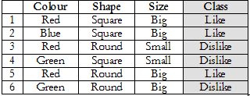
Example: Data to Rules
Below is a small dataset about Sweets, collected from children at a kindergarten in Nairobi. They indicated what they liked and did not like.

Slide 6
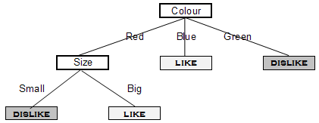
Example: Data to Rules
Below is a small dataset about Sweets, collected from children at a kindergarten in Nairobi. They indicated what they liked and did not like.
Where is each instance captured on the decision tree?

Slide 7
Example: Data to Rules
Below is a small dataset about Sweets, collected from children at a kindergarten in Nairobi. They indicated what they liked and did not like.
Rule from data: Like Sweet
IF Colour is Blue OR IF Colour is Red AND Size = Big
The decision rule
Notes:
Would the following be liked?
-Big green lollipop
-Big red lollipop

Slide 8
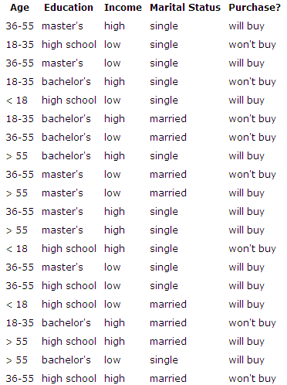
Example1: Data
Manufacture does market survey of who bought an electronic product. : Data

Slide 9
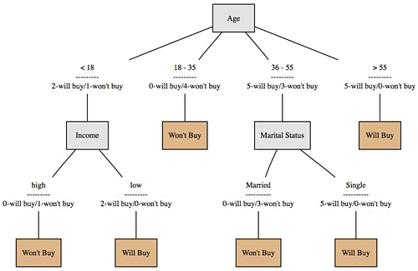
Example 1: Data to Tree
Manufacture does market survey of who bought the product : Induced Decision Tree

Slide 10
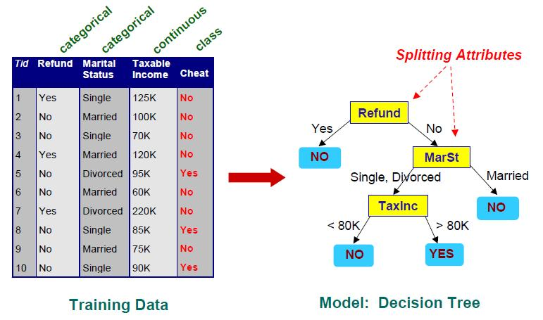
Example 2 – KRA Tax returns
Illustrates an example decision tree for predicting whether a person cheats on their taxes

Slide 11
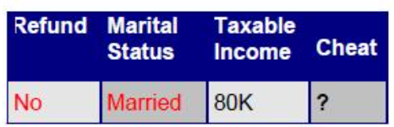
Example 2 – KRA Tax returns
Will this person cheat?

Slide 12
Example 3 – Buying a computer
age?
<=30
31..40
>40
student?
yes
credit rating?
no
yes
excellent
fair
no
yes
no
yes

Slide 13
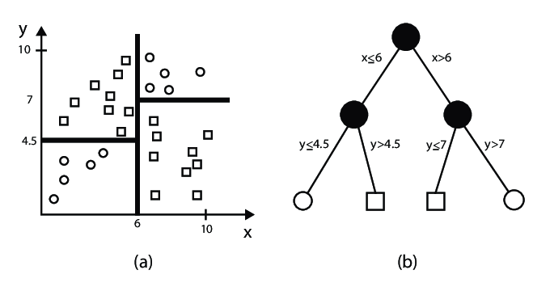
Example 4: Plotted data partitioned by a decision tree
Source: Dora Szücs, Florian Schmidt, Decision Tree Visualization for High-dimensional Numerical Data October 2018 (Technische Universität Berlin)

Slide 14
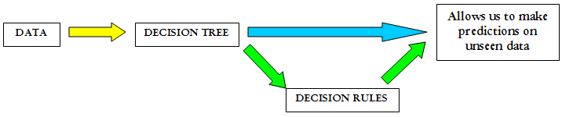
Decision Trees
A decision tree is constructed by looking for regularities in data

Slide 15
Example: Sweets Data
Assume:
Positive (+ve) class is Like
Negative (-ve) class is Dislike
Counting +ve and –ve instances
+ve examples are 3 hence represent as 3+
-ve examples are 3 hence represent as 3-

Slide 16
PlayTennis Training Examples
Day
Outlook
Temp.
Humidity
Wind
Play Tennis
D1
Sunny
Hot
High
Weak
No
D2
Sunny
Hot
High
Strong
No
D3
Overcast
Hot
High
Weak
Yes
D4
Rain
Mild
High
Weak
Yes
D5
Rain
Cool
Normal
Weak
Yes
D6
Rain
Cool
Normal
Strong
No
D7
Overcast
Cool
Normal
Weak
Yes
D8
Sunny
Mild
High
Weak
No
D9
Sunny
Cold
Normal
Weak
Yes
D10
Rain
Mild
Normal
Strong
Yes
D11
Sunny
Mild
Normal
Strong
Yes
D12
Overcast
Mild
High
Strong
Yes
D13
Overcast
Hot
Normal
Weak
Yes
D14
Rain
Mild
High
Strong
No

Slide 17
Decision Tree for PlayTennis
Outlook
Sunny
Overcast
Rain
Humidity
Yes
Wind
High
Normal
Strong
Weak
No
Yes
No
Yes

Slide 18
Decision Tree for PlayTennis
Outlook
Sunny
Overcast
Rain
Humidity
Each internal node tests an attribute
High
Normal
Each branch corresponds to an
attribute value node
No
Yes
Each leaf node assigns a classification

Slide 19
Decision Tree for PlayTennis
Outlook Temperature Humidity Wind PlayTennis
Sunny Hot High Weak ?
No
Outlook
Sunny
Overcast
Rain
Humidity
Yes
Wind
High
Normal
Strong
Weak
No
Yes
No
Yes

Slide 20
Decision Tree for Conjunction
Outlook=Sunny ∧ Wind=Weak
Outlook
Sunny
Overcast
Rain
Wind
No
No
Strong
Weak
No
Yes

Slide 21
Decision Tree for Disjunction
Outlook=Sunny ∨ Wind=Weak
Outlook
Sunny
Overcast
Rain
Yes
Wind
Wind
Strong
Weak
Strong
Weak
No
Yes
No
Yes

Slide 22
Decision Tree for XOR
Outlook=Sunny XOR Wind=Weak
Outlook
Sunny
Overcast
Rain
Wind
Wind
Wind
Strong
Weak
Strong
Weak
Strong
Weak
Yes
No
No
Yes
No
Yes

Slide 23
Decision Tree
Decision trees represent disjunctions of conjunctions
Outlook
Sunny
Overcast
Rain
Humidity
Yes
Wind
High
Normal
Strong
Weak
No
Yes
No
Yes
(Outlook=Sunny ∧ Humidity=Normal)
∨ (Outlook=Overcast)
∨ (Outlook=Rain ∧ Wind=Weak)

Slide 24
When to consider Decision Trees
Instances describable by attribute-value pairs
Target function is discrete valued
Disjunctive hypothesis may be required
Possibly noisy training data
Missing attribute values
Examples:
Medical diagnosis
Credit risk analysis
Object classification for robot manipulator (Tan 1993)

Slide 25
Algorithm for Induction of Decision Tree
Basic algorithm (a greedy algorithm)
Tree is constructed in a top-down recursive divide-and-conquer manner
At start, all the training examples are at the root
Attributes are categorical (if continuous-valued, they are discretized in advance)
Examples are partitioned recursively based on selected attributes
Test attributes are selected on the basis of a heuristic or statistical measure (e.g., information gain)
Conditions for stopping partitioning
All samples for a given node belong to the same class
There are no remaining attributes for further partitioning – majority voting is employed for classifying the leaf
There are no samples left

Slide 26
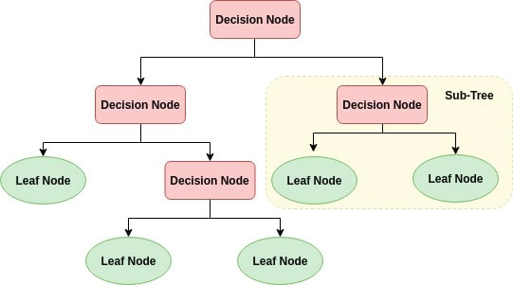
Decision tree
A recursive tree, until all instances are placed

Slide 27
Top-Down Induction of Decision Trees -ID3 Algorithm (By J. Ross Quinlan)
A ← the “best” decision attribute for next node
Assign A as decision attribute for node
For each value of A create new descendant
Sort training examples to leaf node according to the attribute value of the branch
If all training examples are perfectly classified (same value of target attribute) stop, else iterate over new leaf nodes.

Slide 28
Entropy
Entropy: A measure used from Information Theory in the ID3 algorithm and many others used in decision tree construction.
Informally, the entropy of a dataset can be considered to be how disordered it is. It has been shown that entropy is related to information, in the sense that the higher the entropy, or uncertainty, of some data, then the more information is required in order to completely describe that data.
In building a decision tree, we aim to decrease the entropy of the dataset until we reach leaf nodes at which point the subset that we are left with is pure, or has zero entropy and represents instances all of one class (all instances have the same value for the target attribute).

Slide 29

Entropy
We measure the entropy of a dataset, S, with respect to one attribute, in this case the target attribute, with the following calculation:
Where P_{i} is the proportion of instances in the dataset that take the i^{th} value of the target attribute
This probability measures give us an indication of how uncertain we are about the data. And we use a log₂ measure as this represents how many bits we would need to use in order to specify what the class (value of the target attribute) is of a random instance.

Slide 30
Entropy (put another way)
Entropy(S)= expected number of bits needed to encode class (+ or -) of randomly drawn members of S (under the optimal, shortest length-code)
Why?
Information theory optimal length code assign
–log₂ p bits to messages having probability p.
So the expected number of bits to encode
(+ or -) of random member of S:
Entropy(S) = -p₊ log₂ p₊ - p₋ log₂ p₋

Slide 31
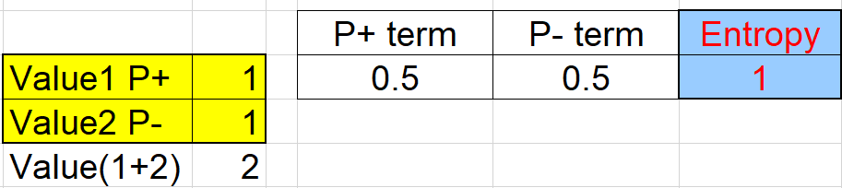
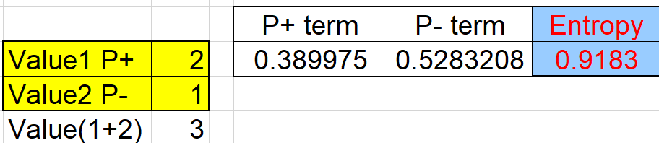
For example,
If P is (1/2, 1/2), then I(P) is 1.
If P is (2/3, 1/3), then I(P) is 0.92,
If P is (1, 0), then I(P) is 0.
The entropy is a way to measure the amount of information.
Example 1
Example 2

Slide 32
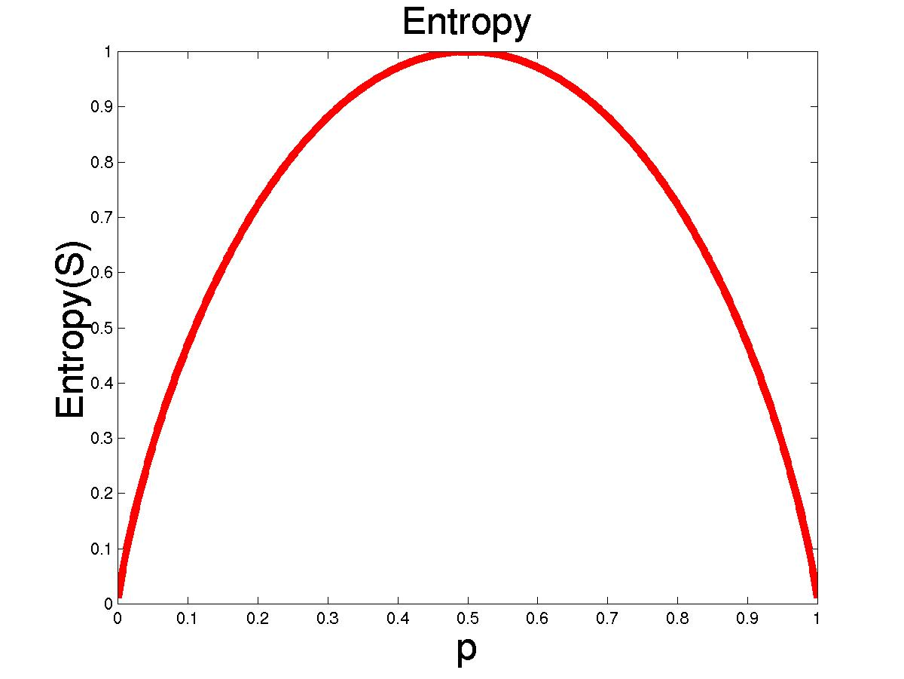
Entropy
S is a sample of training examples
p₊ is the proportion of positive examples
p₋ is the proportion of negative examples
Entropy measures the impurity of S
Entropy(S) = -p₊ log₂ p₊ - p₋ log₂ p₋

Slide 33

Information Gain
Given entropy as a measure of the impurity in a collection of training examples, we can now define a measure of the effectiveness of an attribute in classifying the training data.
The measure we will use, called information gain, is simply the expected reduction in entropy caused by partitioning the examples according to this attribute. More precisely, the information gain, Gain(S, A) of an attribute A, relative to a collection of examples S, is defined as

Slide 34
Which Attribute is ”best”? Sweets example
colour=?
[3+,3-]
[3+,3-]
Size=?
[3+,3-]
Shape=?
Big
Small
Round
Square
Red
Blue
Green
[3+,1-]
[0+,2-]
[1+,2-]
[2+,1-]
[2+,1-]
[1+,0-]
[0+,2-]
Shape Entropy(S)=1
Shape Entropy(S,size_big)=0.81
Shape Entropy(S,size_small)=0.0
1 – (4/6(0.81)+2/6(0)) =1-0.54=0.46
Notes:
Shape Entropy(S)=1
Shape Entropy(S,Shape_round)=0.92
Shape Entropy(S,Shape_square)=0.92
1 – (3/6(0.92)+3/6(0.92)) =1-0.92=0.08
Size Entropy(S)=1
Size Entropy(S,size_big)=0.81
Size Entropy(S,size_small)=0.
1 – (4/6(0.81)+2/6(0)) =1-0.54=0.46

Slide 35
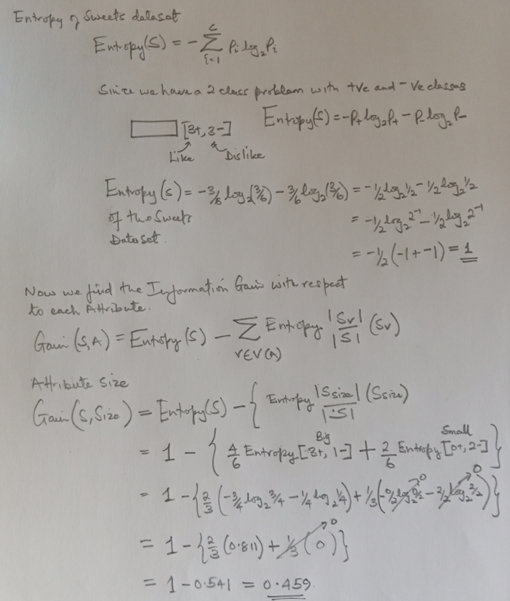
[3+,3-]
Size=?
Big
Small
[3+,1-]
[0+,2-]

Slide 36
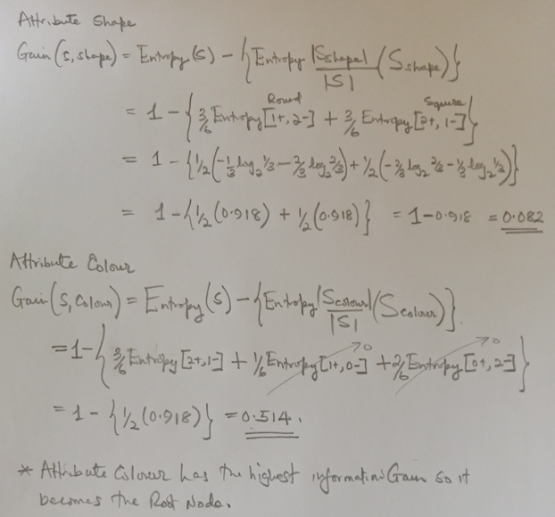
[3+,3-]
Shape=?
Round
Square
[1+,2-]
[2+,1-]
colour=?
[3+,3-]
Red
Blue
Green
[2+,1-]
[1+,0-]
[0+,2-]

Slide 37
Which Attribute is ”best”? Sweets example
Information Gain for each Attributes : Gain(Sweets,Shape)=0.0817
Gain(Sweets,Size)=0.4591
Gain(Sweets,Colour)=0.5409
Colour becomes Root Node
Expand tree using Colour Attribute
Branches for Blue and Green attribute values terminate
Now iterate again for Colour Red attribute value with a subset of the data
Colour
Red
Blue
Green
?
[2+,1-]
LIKE
DISLIKE

Slide 38
Which Attribute is ”best”? Sweets example
Information Gain for each Attributes : Gain(Sweets,Shape)=0.0817
Gain(Sweets,Size)=0.4591
Gain(Sweets,Colour)=0.5409
Colour becomes Root Node
Expand tree using Colour Attribute
Branches for Blue and Green attribute values terminate
Now iterate again for Colour Red attribute value with a subset of the data
Colour
Red
Blue
Green
?
[2+,1-]
LIKE
DISLIKE

Slide 39
Which Attribute is ”best”? Sweets example
Information Gain for each Attributes : Gain(Sweets,Colour Red, Shape)=0.251
Gain(Sweets,Colour Red, Size)=0.9183
Size becomes next Node under the Red attribute Value branch
The tree then terminates
Colour
Red
Blue
Green
?
[2+,1-]
LIKE
DISLIKE

Slide 40
PlayTennis Training Examples
Day
Outlook
Temp.
Humidity
Wind
Play Tennis
D1
Sunny
Hot
High
Weak
No
D2
Sunny
Hot
High
Strong
No
D3
Overcast
Hot
High
Weak
Yes
D4
Rain
Mild
High
Weak
Yes
D5
Rain
Cool
Normal
Weak
Yes
D6
Rain
Cool
Normal
Strong
No
D7
Overcast
Cool
Normal
Weak
Yes
D8
Sunny
Mild
High
Weak
No
D9
Sunny
Cold
Normal
Weak
Yes
D10
Rain
Mild
Normal
Strong
Yes
D11
Sunny
Mild
Normal
Strong
Yes
D12
Overcast
Mild
High
Strong
Yes
D13
Overcast
Hot
Normal
Weak
Yes
D14
Rain
Mild
High
Strong
No

Slide 41
Selecting the Next Attribute
S=[9+,5-]
E=0.940
S=[9+,5-]
E=0.940
Humidity
Wind
High
Normal
Weak
Strong
[3+, 4-]
[6+, 1-]
[6+, 2-]
[3+, 3-]
E=0.592
E=0.811
E=0.985
E=1.0
Gain(S,Humidity)
=0.940 - (7/14)*0.985 – (7/14)*0.592
=0.151
Gain(S,Wind)
=0.940 - (8/14)*0.811 – (6/14)*1.0
=0.048
Humidity provides greater info. gain than Wind, w.r.t target classification.

Slide 42
Selecting the Next Attribute
S=[9+,5-]
E=0.940
Outlook
Over
cast
Sunny
Rain
[2+, 3-]
[4+, 0]
[3+, 2-]
E=0.971
E=0.0
E=0.971
Gain(S,Outlook)
=0.940 - (5/14)*0.971 - (4/14)*0.0 – (5/14)*0.0971
=0.247

Slide 43
Selecting the Next Attribute
The information gain values for the 4 attributes are:
Gain(S,Outlook) =0.247
Gain(S,Humidity) =0.151
Gain(S,Wind) =0.048
Gain(S,Temperature) =0.029
where S denotes the collection of training examples

Slide 44
PlayTennis Training Examples (Outlook = Sunny) (use subset of original dataset)
Day
Outlook
Temp.
Humidity
Wind
Play Tennis
D1
Sunny
Hot
High
Weak
No
D2
Sunny
Hot
High
Strong
No
D3
Overcast
Hot
High
Weak
Yes
D4
Rain
Mild
High
Weak
Yes
D5
Rain
Cool
Normal
Weak
Yes
D6
Rain
Cool
Normal
Strong
No
D7
Overcast
Cool
Normal
Weak
Yes
D8
Sunny
Mild
High
Weak
No
D9
Sunny
Cold
Normal
Weak
Yes
D10
Rain
Mild
Normal
Strong
Yes
D11
Sunny
Mild
Normal
Strong
Yes
D12
Overcast
Mild
High
Strong
Yes
D13
Overcast
Hot
Normal
Weak
Yes
D14
Rain
Mild
High
Strong
No

Slide 45
ID3 Algorithm
[D1,D2,…,D14]
[9+,5-]
Outlook
Sunny
Overcast
Rain
S_{sunny}=[D1,D2,D8,D9,D11]
[2+,3-]
[D3,D7,D12,D13]
[4+,0-]
[D4,D5,D6,D10,D14]
[3+,2-]
?
Yes
?
Gain(S_{sunny} , Humidity)=0.970-(3/5)0.0 – 2/5(0.0) = 0.970
Gain(S_{sunny} , Temp.)=0.970-(2/5)0.0 –2/5(1.0)-(1/5)0.0 = 0.570
Gain(S_{sunny} , Wind)=0.970= -(2/5)1.0 – 3/5(0.918) = 0.019

Slide 46
ID3 Algorithm
Outlook
Sunny
Overcast
Rain
Humidity
Yes
Wind
[D3,D7,D12,D13]
High
Normal
Strong
Weak
No
Yes
No
Yes
[D1,D2]
[D8,D9,D11]
[D6,D14]
[D4,D5,D10]

Slide 47
Occam’s Razor
Why prefer short hypotheses?
Argument in favor:
Fewer short hypotheses than long hypotheses
A short hypothesis that fits the data is unlikely to be a coincidence
A long hypothesis that fits the data might be a coincidence
Argument opposed:
There are many ways to define small sets of hypotheses
E.g. All trees with a prime number of nodes that use attributes beginning with ”Z”
What is so special about small sets based on size of hypothesis

Slide 48
Overfitting
One of the biggest problems with decision trees is Overfitting
It occurs when our machine learning model is not able to capture the underlying trend of the data.
To avoid the overfitting in the model, the feed for training data can be stopped at an early stage, due to which the model may not learn enough from the training data.

Slide 49
Avoid Overfitting
How can we avoid overfitting?
Stop growing when data split not statistically significant
Grow full tree then post-prune
Minimum description length (MDL):
Minimize:
size(tree) + size(misclassifications(tree))

Slide 50
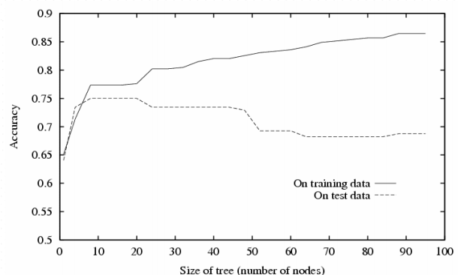
Overfitting in Decision Tree Learning

Slide 51
Converting a Tree to Rules
Outlook
Sunny
Overcast
Rain
Humidity
Yes
Wind
High
Normal
Strong
Weak
No
Yes
No
Yes
R₁: If (Outlook=Sunny) ∧ (Humidity=High) Then PlayTennis=No
R₂: If (Outlook=Sunny) ∧ (Humidity=Normal) Then PlayTennis=Yes
R₃: If (Outlook=Overcast) Then PlayTennis=Yes
R₄: If (Outlook=Rain) ∧ (Wind=Strong) Then PlayTennis=No
R₅: If (Outlook=Rain) ∧ (Wind=Weak) Then PlayTennis=Yes

Slide 52
Continuous Valued Attributes
Create a discrete attribute to test continuous
Temperature = 24.5⁰C
(Temperature > 20.0⁰C) = {true, false}
Where to set the threshold?
Other examples attributes that can be discretized are:
Age, Weight, Height,… all depending on the domain or context of the data
Temperature
15⁰C
18⁰C
19⁰C
22⁰C
24⁰C
27⁰C
PlayTennis
No
No
Yes
Yes
Yes
No

Slide 53
Attributes with many Values
Problem: if an attribute has many values, maximizing InformationGain will select it.
E.g.: Imagine using Date=27.3.2002 as attribute
perfectly splits the data into subsets of size 1
A Solution:
Use GainRatio instead of information gain as criteria:
GainRatio(S,A) = Gain(S,A) / SplitInformation(S,A)
SplitInformation(S,A) = -Σ_{i=1..c} |S_{i}|/|S| log₂ |S_{i}|/|S|
Where S_{i} is the subset for which attribute A has the value v_{i}

Slide 54
Unknown Attribute Values
What if some examples have missing values of A?
Use training example anyway sort through tree
If node n tests A, assign most common value of A among other examples sorted to node n.
Assign most common value of A among other examples with same target value
Assign probability pi to each possible value vi of A
Assign fraction pi of example to each descendant in tree
Classify new examples in the same fashion

Slide 55
Comparing Attribute Selection Measures
The three measures, in general, return good results but
Information gain:
biased towards multivalued attributes
Gain ratio:
tends to prefer unbalanced splits in which one partition is much smaller than the others
Gini index:
biased to multivalued attributes
has difficulty when # of classes is large
tends to favor tests that result in equal-sized partitions and purity in both partitions

Slide 56
Overfitting and Tree Pruning
Overfitting: An induced tree may overfit the training data
Too many branches, some may reflect anomalies due to noise or outliers
Poor accuracy for unseen samples
Two approaches to avoid overfitting
Pre-pruning: Halt tree construction early ̵ do not split a node if this would result in the goodness measure falling below a threshold
Difficult to choose an appropriate threshold
Post-pruning: Remove branches from a “fully grown” tree—get a sequence of progressively pruned trees
Use a set of data different from the training data to decide which is the “best pruned tree”

Slide 57
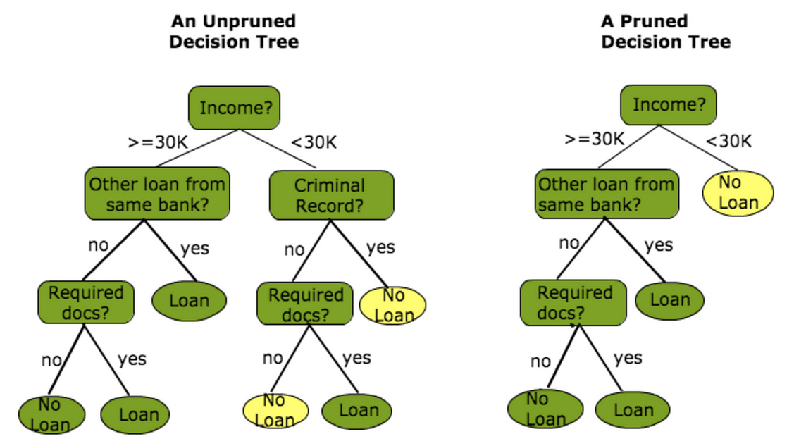
Overfitting and Tree Pruning
Decision Tree Pruning
Source: https://kaumadiechamalka100.medium.com/decision-tree-in-machine-learning-c610ef087260

Slide 58
Strengths of Decision Tree Learning
Decision trees are able to generate understandable rules.
Decision trees perform classification without requiring much computation.
Decision trees are able to handle both continuous and categorical variables.
Decision trees provide a clear indication of which fields are most important for prediction or classification.

Slide 59
C4.5 algorithm
C4.5 is an improvement on ID3 Algorithm. Some of these are:
Handling both continuous and discrete attributes - In order to handle continuous attributes
Handling training data with missing attribute values - C4.5 allows attribute values to be marked as ? for missing. Missing attribute values are simply not used in gain and entropy calculations.
Handling attributes with differing costs.
Pruning trees after creation - C4.5 goes back through the tree once it's been created and attempts to remove branches that do not help by replacing them with leaf nodes.
J4.8 in WEKA ML Toolkit – is the further enhanced C4.5

Slide 60
Others Decision Tree Algorithms
CART (Classification And Regression Tree)
Uses Gini’s impurity index
CHAID (CHi-squared Automatic Interaction Detector).
Performs multi-level splits when computing classification trees.
MARS
extends decision trees to handle numerical data better.

Slide 61
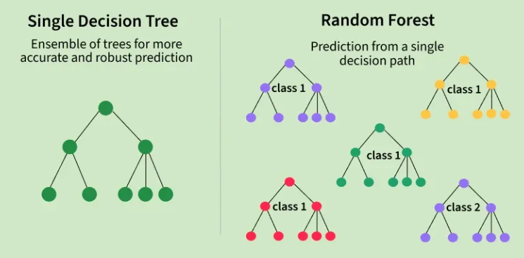
Random Forest
Source: https://www.geeksforgeeks.org/machine-learning/random-forest-algorithm-in-machine-learning/
Random Forest makes better forecasts by using a large number of decision trees. It is an ensemble learning technique because each tree examines distinct random portions of the data, and their findings are integrated by voting for classification or averaging for regression. This aids in decreasing errors and increasing accuracy.

